Slide 1


Slide 2
What is the Boosting Algorithm?
Boosting algorithms are the special algorithms that are used to augment the existing result of the data model and help to fix the errors. They use the concept of the weak learner and strong learner conversation through the weighted average values and higher votes values for prediction. These algorithms uses decision stamp, margin maximizing classification for processing. There are three types of Algorithms available such as
  AdaBoost (Adaptive boosting) Algorithm
  Gradient Boosting algorithm
  XG Boosting algorithm.
These are the machine learning algorithms that follow the process of training for predicting and fine-tuning the result.

Slide 3
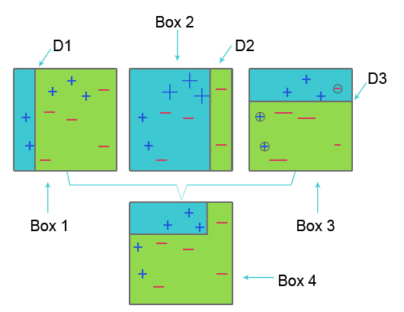
AdaBoost (Adaptive Boosting) Algorithm
Box 1: In Box 1, for each data set, we assigned equal weights and to classify plus (+) and minus (-) sign, we apply decision stump D1, which creates a vertical line at the left-hand side of box 1. This line incorrectly predicted three-plus sign(+) as minus(-); hence we apply higher weights to these plus sign and apply another decision stump.
Box 2: In Box 2, the size of three incorrectly predicted plus signs (+) becomes bigger as compared to another. The second decision stump D2 at the right-hand side of the block predict this incorrectly predicted plus sign (+) sign as correct. But since misclassification error occurred because of the unequal weight with a minus sign (-), we assign a higher weight to a minus sign (-) and apply another decision stump
Box 3: In Box three, because of misclassification error, three minus sign (-) has a high weight. here decision stump D3 is applied to predict this misclassification and correct it. This time to classify plus (+) and minus (-) sign horizontal line is created.
Box 4: In Box 4, decision stump D1, D2 and D3 are combined to create a new strong prediction.

Slide 4
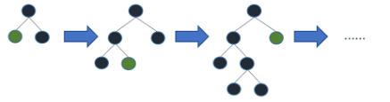
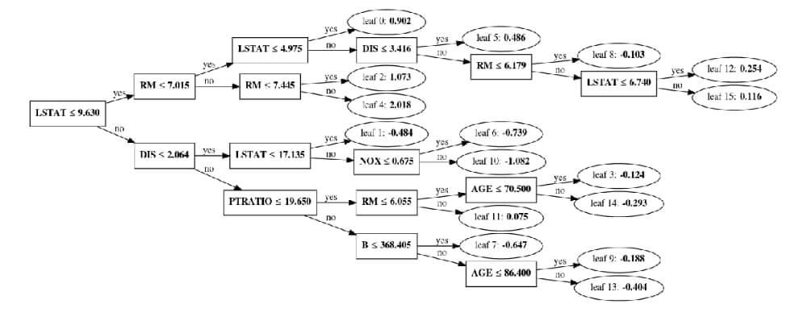
LG Boost
A LightGBM regression model is made up of n_estimators (default value is 100) relatively small decision trees that are called weak learners, or sometimes base learners. The weak trees are constructed sequentially where each tree uses gradients of the error from the previous tree.
Better accuracy than any other boosting algorithm: It produces much more complex trees by following leaf wise split approach rather than a level-wise approach which is the main factor in achieving higher accuracy.

Slide 5
Gradient Boosting Algorithm
1. Loss Function
The use of the loss function depends on the type of problem. The advantage of gradient boosting is that there is no need for a new boosting algorithm for each loss function.
2. Weak Learner
In gradient boosting, decision trees are used as a weak learner. A regression tree is used to give true values, which can be combined together to create correct predictions. Like in the AdaBoost algorithm, small trees with a single split are used, i.e. decision stump. Larger trees are used for large levels I,e 4-8 levels.
3. Additive Model
In this model, trees are added one at a time. existing trees remains the same. During the addition of trees, gradient descent is used to minimize the loss function.

Slide 6
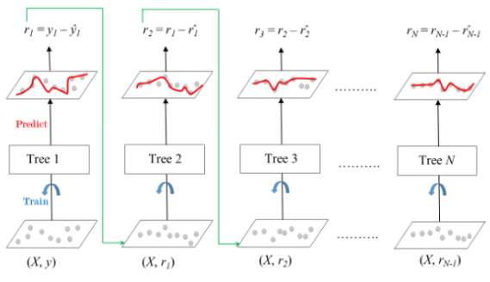
Gradient Boosting Algorithm
Gradient boosting is a machine learning technique used in regression and classification tasks, among others. It gives a prediction model in the form of an ensemble of weak prediction models, i.e., models that make very few assumptions about the data, which are typically simple decision trees.

Slide 7
XG Boost
XG Boost is short for Extreme Gradient Boosting. XG Boost is an upgraded implementation of the Gradient Boosting Algorithm, which is developed for high computational speed, scalability, and better performance.
XG Boost has various features, which are as follows:
Parallel Processing: XG Boost provides Parallel Processing for tree construction which uses CPU cores while training.Cross-Validation: XG Boost enables users to run cross-validation of the boosting process at each iteration, making it easy to get the exact optimum number of boosting iterations in one run.
Cache Optimization: It provides Cache Optimization of the algorithms for higher execution speed.
Distributed Computing: For training large models, XG Boost allows Distributed Computing.

Slide 8
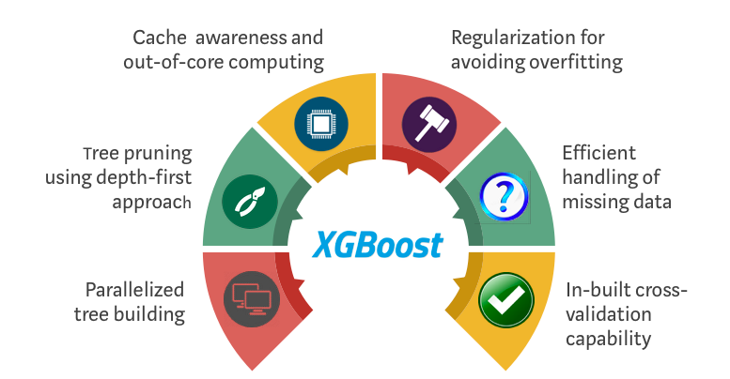
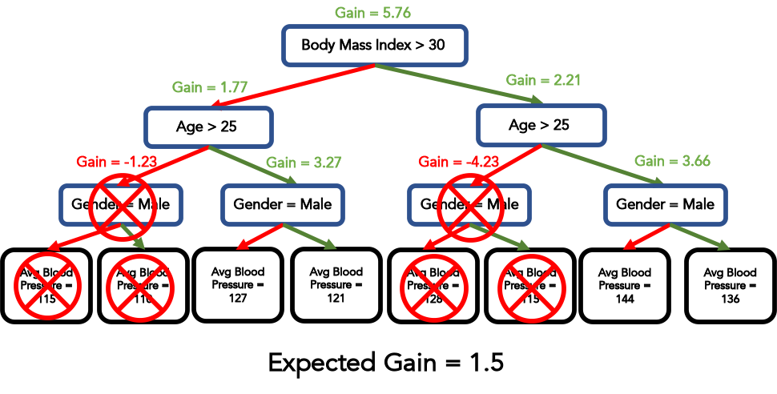
XG Boost

